Slide 1
Lingaraja Temple
Lingaraja Temple is a Hindu temple dedicated to Shiva
one of the oldest temples in Bhubaneswar
The temple represents the quintessence of the Kalinga Architecture and culminating the medieval stages of the architectural tradition at Bhubaneswar
The temple’s structure is made up of the stone of the darkest shade.
The temple is built in vast area in Bhubaneshawara and the height of the temple is around 55meteres.
Beautiful scriptures have been carved onto the walls of the temple
Lion gate where lions on both the sides of the gate and the lions crushing an elephant have been showcased at the lion entrance.

Slide 2
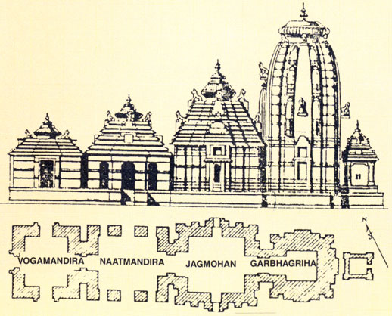
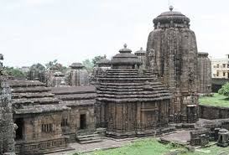
The temple is built in the Deula style that has four components namely,
vimana (structure containing the sanctum),
jagamohana (assembly hall),
natamandira (festival hall) and
bhoga-mandapa (hall of offerings), each increasing in the height to its predecessor.

